Slide 1
PGM in Modern AI Approaches
Eric Walzthöny
Shanshan Zhang
2022-05-24

Slide 2



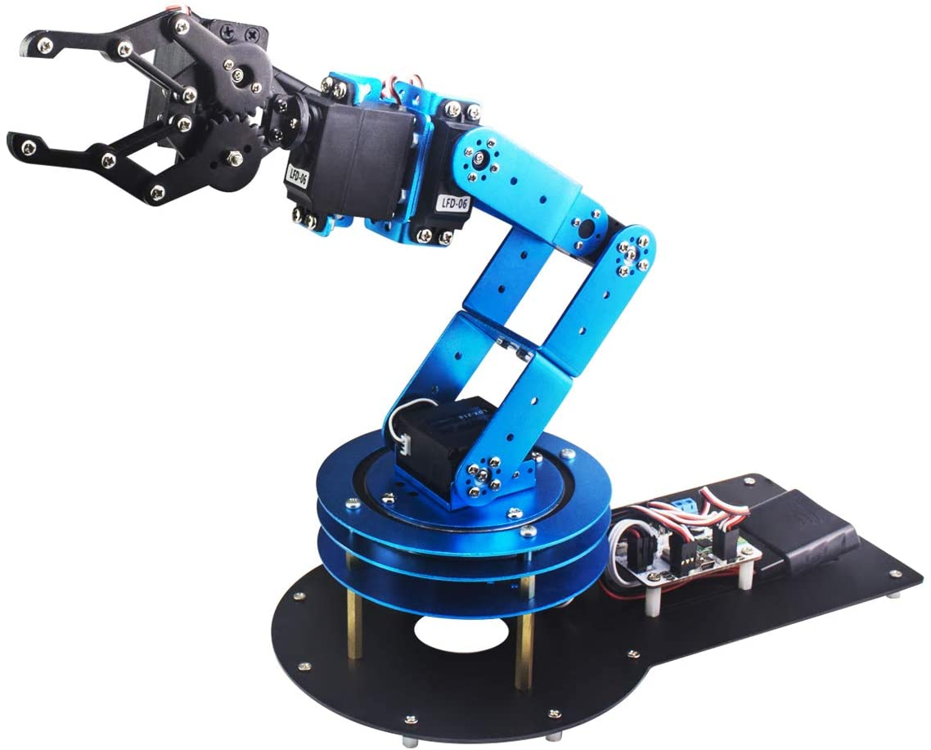
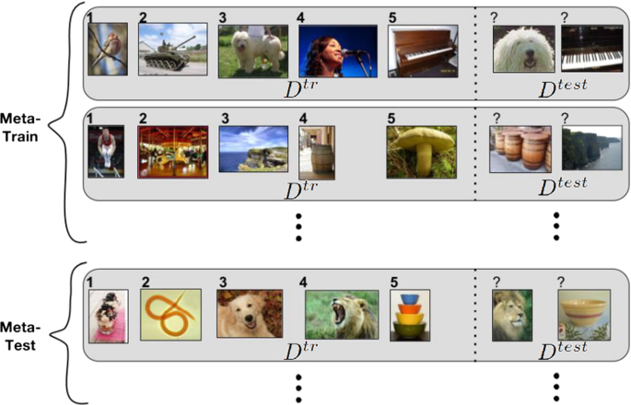
Contents
Transfer Learning
Transformer
Meta Learning
Deep
Reinforcement Learning
Deep Generative Models

Slide 6
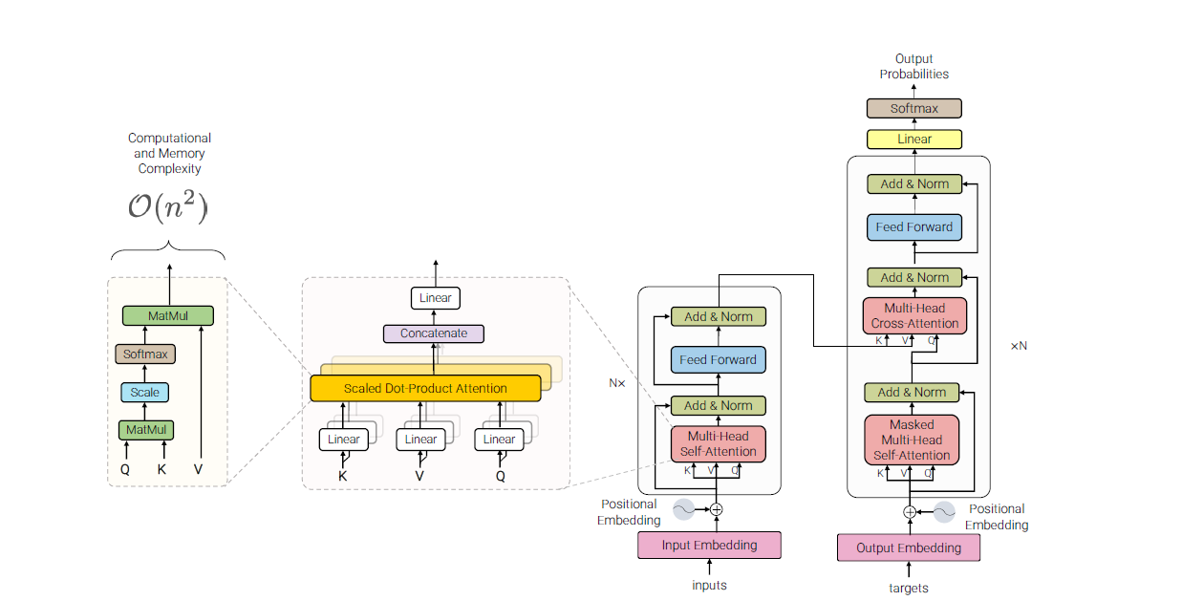
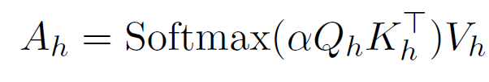


Transformers
Multi-Head Self-Attention
O(n²)Both training and inference
~1/2
Layer-norm and residual connection
Multi-Head Self-Attention
Position-wise Feed-
forward Layers
~1/2
Layer-norm and residual connection
Attention is all you need https://arxiv.org/pdf/1706.03762.pdf
Notes:
The inputs and output of the multi-headed self-attention module are connected by residual connectors and a layer normalization layer. The output of the multi-headed self-attention module is then passed to a two-layered feed-forward network which has its inputs/outputs similarly connected in a residual fashion with layer normalization.

Slide 7
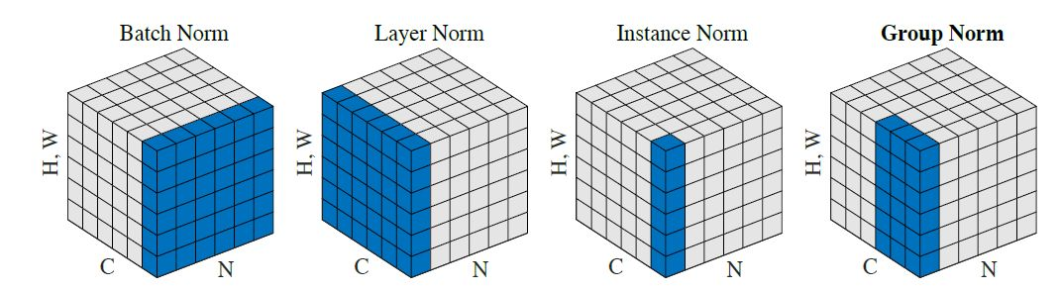
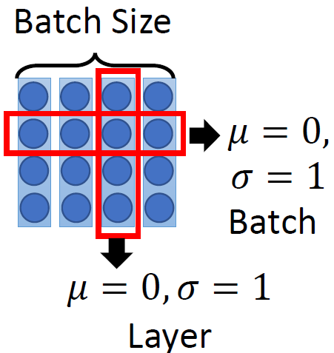
Different Normalization
BN VS. LN

Slide 8
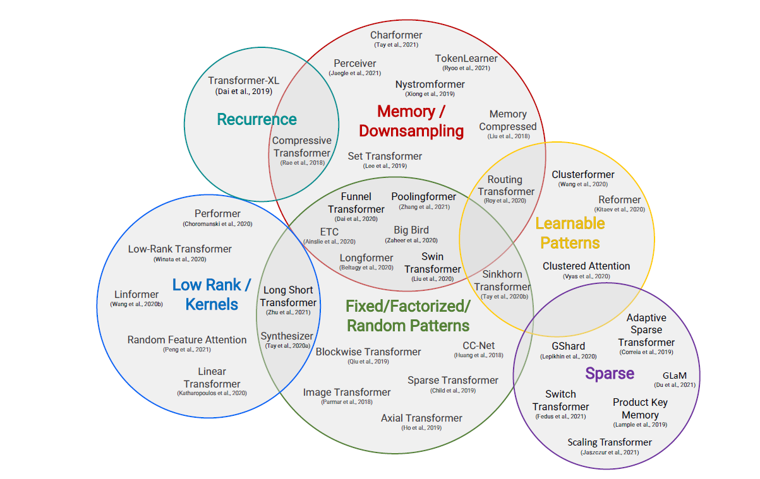
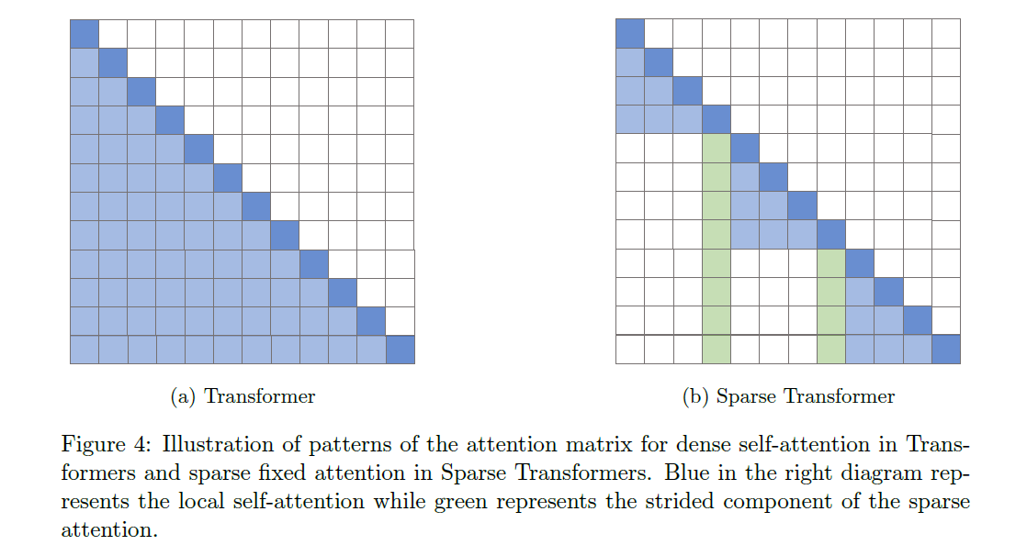
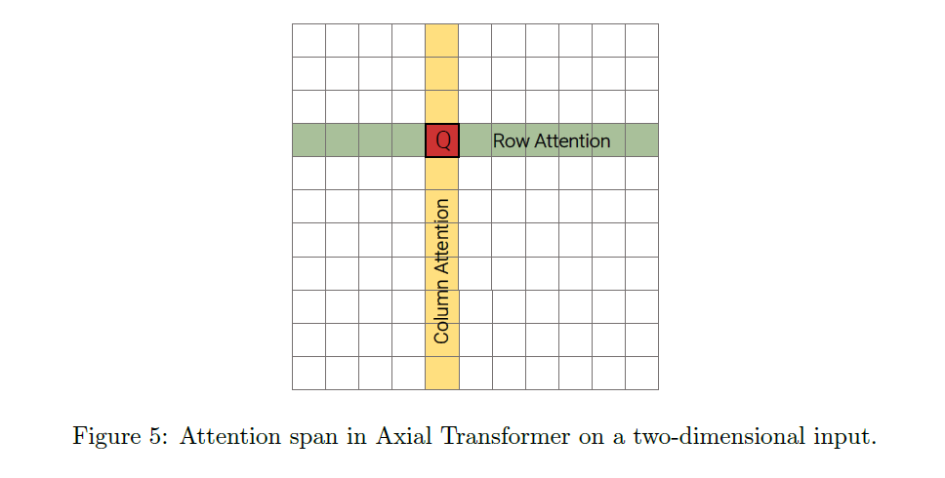
Efficient Transformers
Sparse Transformer
Axical Transformer
Efficient Transformers: https://arxiv.org/pdf/2009.06732.pdf

Slide 9
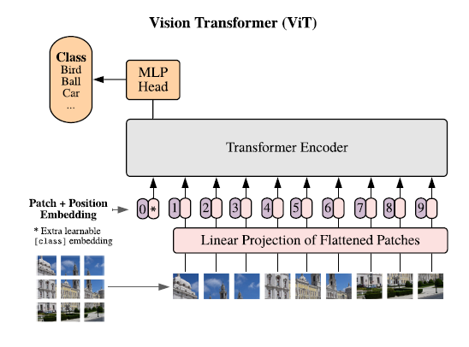

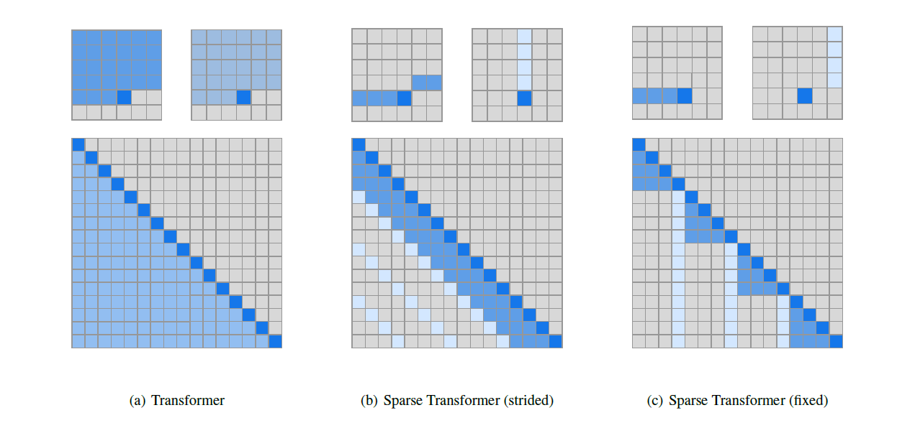
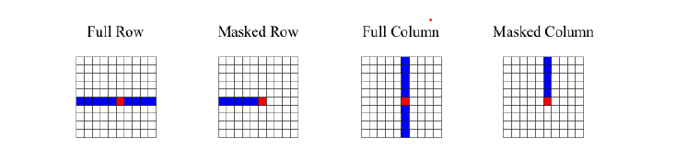
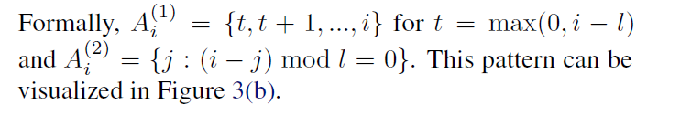
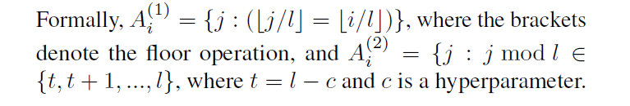
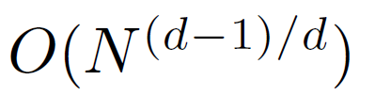
Sparse vs. axial attention
Vision Transformer https://arxiv.org/pdf/2010.11929.pdf
Sparse Transformer https://arxiv.org/pdf/1912.12180.pdf
Axial Transformer https://arxiv.org/pdf/1912.12180.pdf
Axial attention over axis k can be implemented by transposing all axes except k to the batch axis, calling standard attention as a subroutine
Notes:
It performs attention over axis k of the tensor x, mixing information along axis k while keeping information along other axes independent. It is straightforward to implement: axial attention over axis k can be implemented by transposing all axes except k to the batch axis, calling standard attention as a subroutine, then undoing the transpose (an alternative is to use the einsum operation available in most deep learning libraries)

Slide 10
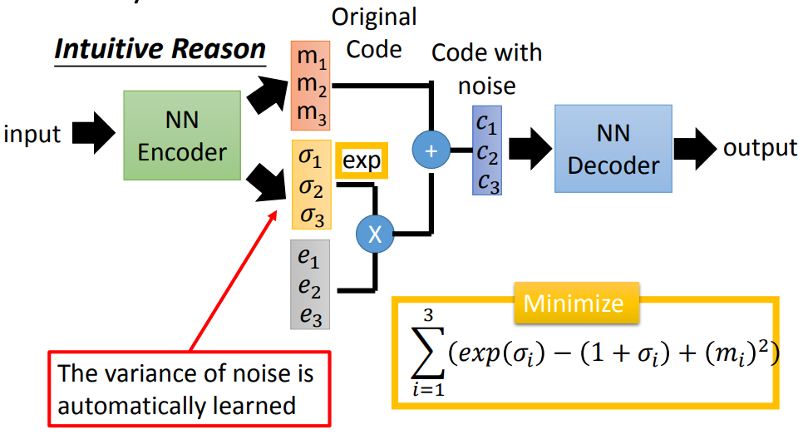
VAE in NN perspective

Slide 11
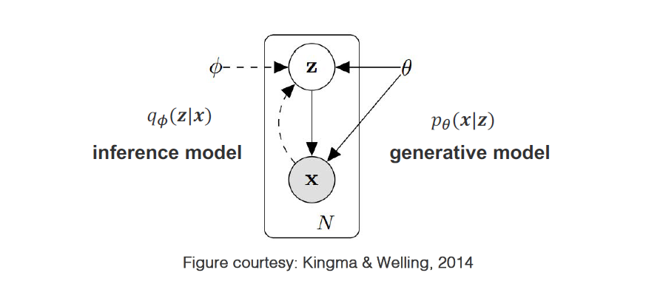


Deep Generative MODELS
Explicit probabilistic models
Provide an explicit parametric specification of the distribution of 𝒙
l Tractable likelihood function p#(𝒙)
l E.g., Deep generative model parameterized with NNs (e.g., VAEs)
l
$$P_{∅}\left(x|z\right) =N(x; μ_{∅}, σ)$$
$$P(z)=N(x;0, I)$$
VAE: https://arxiv.org/pdf/1312.6114.pdf

Slide 12



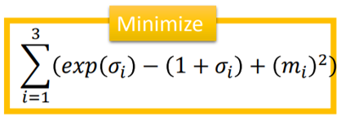
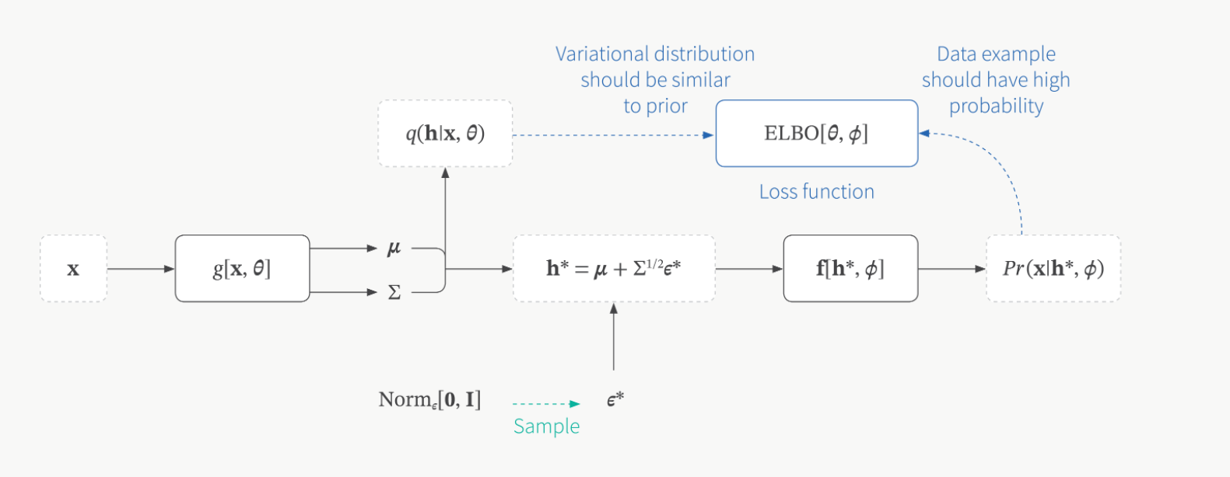
Variational Inference in VAE
Maximize log likelihood
Jensen’s
inequality
Minimize
Reconstruction Error

Slide 13
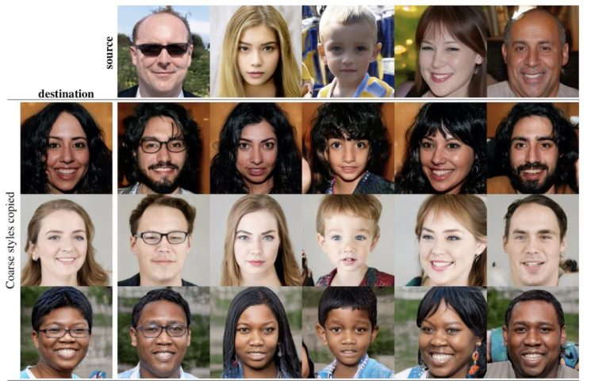
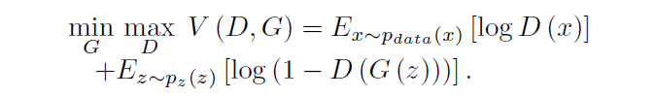
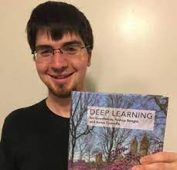
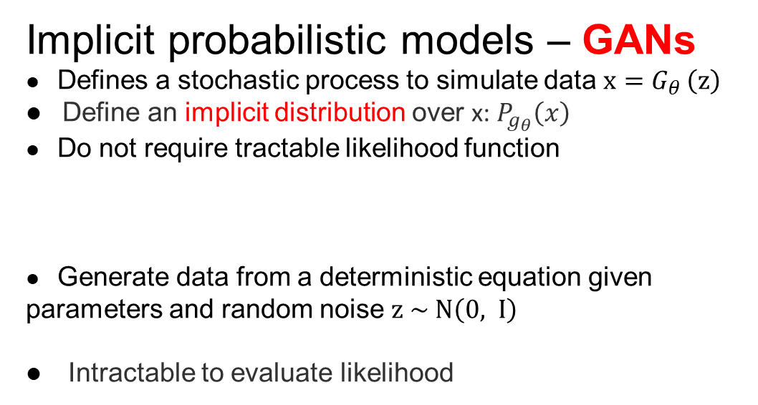

DEEP GENERATIVE MODEL
Implicit probabilistic models – GANs
l Defines a stochastic process to simulate data $x=G_{θ }\left(z\right)$
l Define an implicit distribution over x: $P_{g_{θ}}\left(x\right)$
l Do not require tractable likelihood function
l Generate data from a deterministic equation given parameters and random noise $z \sim N\left(0, I\right)$
l Intractable to evaluate likelihood
Mode Collapse?!
Motivating entropy
regularization!!
Adding the entropy of G$(z)$) to the objective
Goodfellow et al., 2014
https://arxiv.org/pdf/1406.2661.pdf

Slide 14
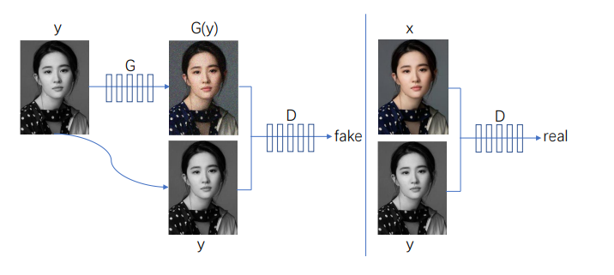
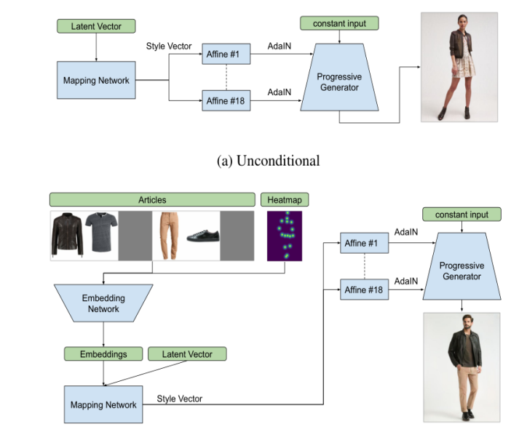
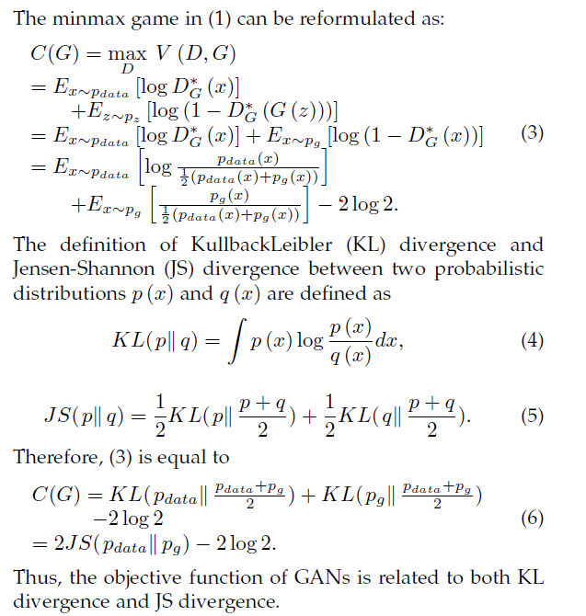
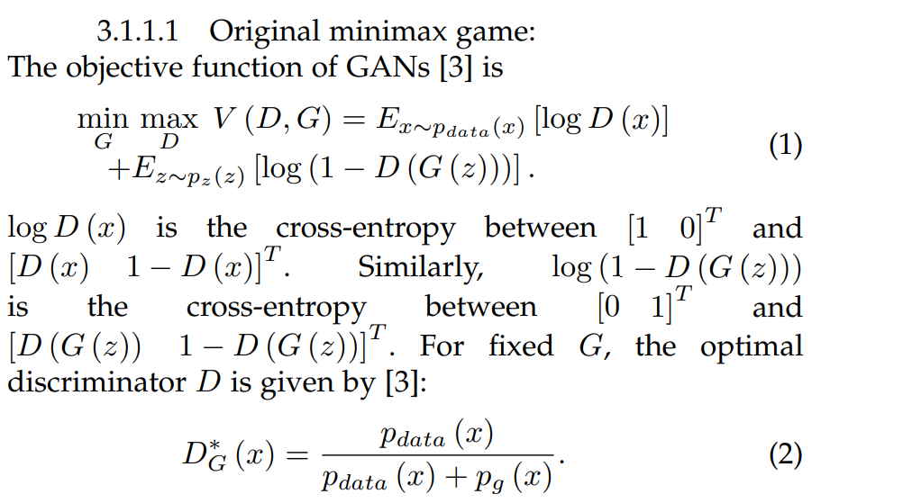
GAN Variants
Pixel2Pixel
Conditional
GAN Survey (including 400+ variants): https://arxiv.org/pdf/2001.06937.pdf

Slide 15
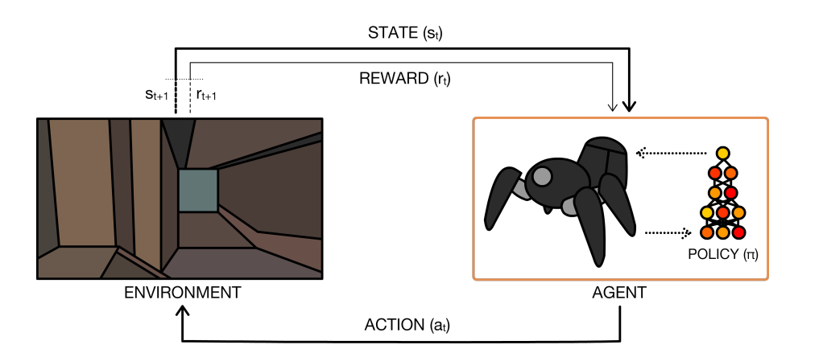
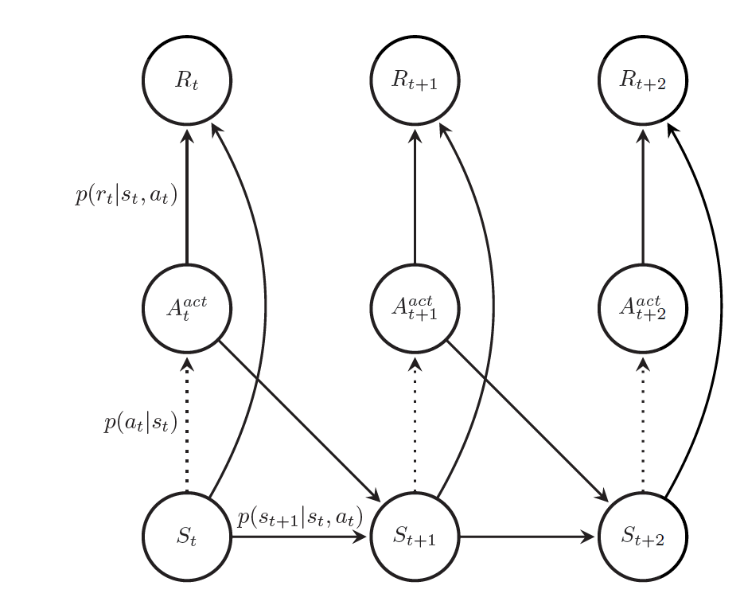
Deep Reinforcement learning
Directed Acyclic Graph
For Markov Decision Process
There are four key ingredients for a RL system:
Environment: Physical world in which the agent operates
State: Current situation of the agent
Reward: Feedback from the environment
Policy: Method to map agent’s state to actions
DRL+PGM survey: https://arxiv.org/pdf/1906.10025.pdf

Slide 16
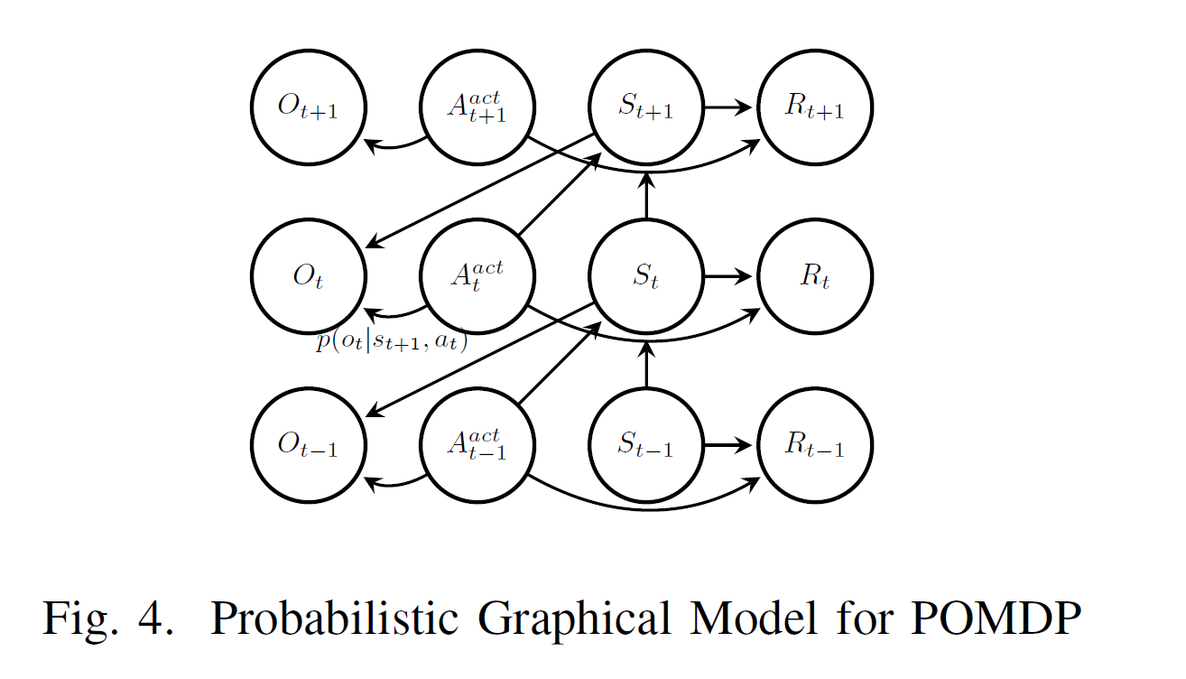

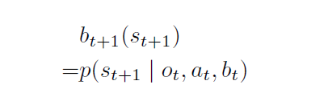

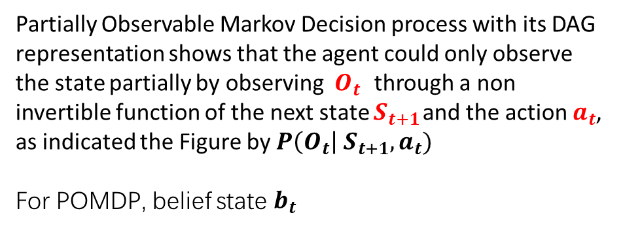
Partially Observable MDP
Partially Observable Markov Decision process with its DAG representation shows that the agent could only observe the state partially by observing $O_{t}$ through a non invertible function of the next state $S_{t+1}$ and the action $a_{t}$, as indicated the Figure by $P\left(O_{t}\right| S_{t+1}, a_{t})$
For POMDP, belief state $b_{t}$
The distributions on other edges are omitted in last slide

Slide 17
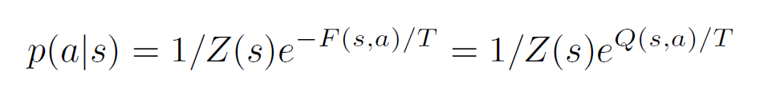
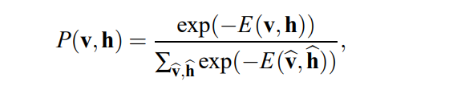
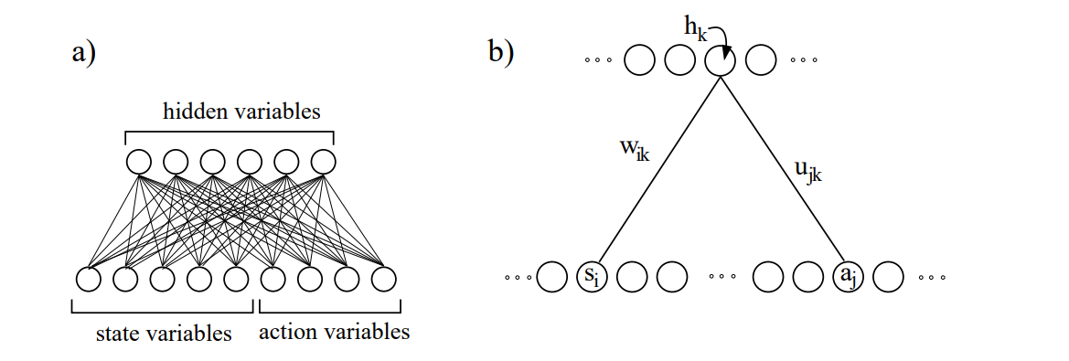
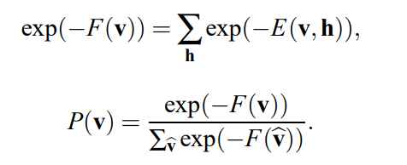


RBM in DRL
Undirected graph defines a joint probability distribution over state and action pairs through hidden state
Approximate the value function of an MDP with the negative free energy of the restricted Boltzmann machine.
Function Approximation Q(S, a)
Temporal Difference Learning
The state and action variables will be assumed to be discrete, and will be represented by the visible binary variables of the restricted Boltzmann machine.
The negative free energy to approximate the state action value function Q(s, a).
Notes:
Since it is pretty easy to calculate the derivative of the free energy F(s; a) with respect to the coefficient wk;j the network, one could use temporal difference learning to update the coefficients in the network. Thanks to properties of Boltzmann Machine, the conditional distribution of action over state p(ajs), which could be used as a policy, is still Boltzmann distributed as in Equation (33), governed by the free energy F(a; s), where Z(s) is the partition function [7] and the negative free energy to approximate the state action value function Q(s; a). By adjusting the temperature T, one could also change between different exploration strength.

